Slide 1
National and Regional
IGF Initiatives (NRIs)
Status update as an input to the Second IGF 2017 Open Consultations and MAG Meeting
IGF Secretariat, NRIs Focal Point, June 2017

Slide 2
Origin and Background
The Tunis Agenda established the Internet Governance Forum (Para. 72)
No specific call for national or regional IGFs
Recognized that multistakeholder approach is a fundamental principle
Encouraged development of multistakeholder processes at national, regional and international level to discuss and collaborate … (Para. 80)
Starting from 2006, many national and regional initiatives began to formalize

Slide 3
Work Principles
NRIs agree to follow the core principles and characteristics of the IGF itself, in order to be formally recognized as IGF initiatives.
Core characteristics and principles:
  Organic
  Autonomous and Independent
  Stakeholders act on equal footing (just as at the IGF itself)
  Bottom up
  Multistakeholder
  Open and Transparent
  Inclusive
  Non commercial
There is no hierarchy between the IGFs at any level.

Slide 4
Continued Evolutionary Growth
2011 (37)
2015 (37)
2017 (87 + 14 ‘in-formation’)

Slide 5
IGF 2017: Total number of recognized and ‘in-formation’ NRIs is 101

Slide 6
Overview of the 2017 NRIs Annual Meetings
60+ NRIs Annual Meetings organized during the 2016 year
January | Trinidad and Tobago IGF | June | EuroDIG Peru IGF Nepal IGF Barbados IGF Central Asia IGF
March | Afghanistan IGF | July | Kenya IGF IGF-USA Asia-Pacific IGF
April | Russia IGF Central Africa IGF Panama IGF Finland IGF | August | LACIGF Caribbean IGF Costa Rica IGF
May | Belarus IGF Croatia IGF Sri Lanka IGF Pacific IGF Senegal IGF SEEDIG Swiss IGF | October | Netherlands IGF Austria IGF

Slide 7
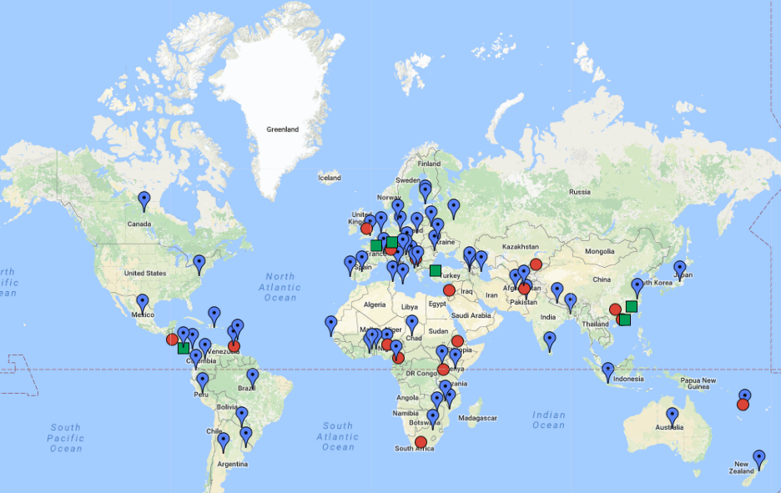
Geographic Coverage – 2017 Global View
* This Map is constantly being updated as new Initiatives are emerging.

Slide 8
What do the NRIs do?
The multistakeholder organizing teams ask their community what Internet Governance issues are of their concern
Develop the programme agenda based on received inputs
Engage the community into the organization of the programme sessions
Organize the annual meeting with respecting the IGF principles
In between the meetings, there are NRIs that have developed the intersessional work (Paraguay IGF: webinars for University students; SEEDIG: Monthly briefings on IG issues in region and regional remote hub; Japan IGF: monthly meetings on IG issues of interest etc.)
How does all this look like in practice?

Slide 9
What do the NRIs do?
The multistakeholder organizing teams identify issues of interest;
Develop the programme based on received inputs;
Engage the community to implement the programme;
Organize annual meetings;
In between the meetings, there are NRIs that have developed the intersessional work (e.g. Portugal IGF: organizing multiple sessions across country; Paraguay IGF: webinars for University students; SEEDIG: Monthly briefings on IG issues in region and regional remote hub; Japan IGF: monthly meetings on IG issues of interest etc.)
Annual Meeting
Public Call for Inputs
Stakeholder engagement
Clustering and reviewing received inputs
Developing Programme

Slide 10
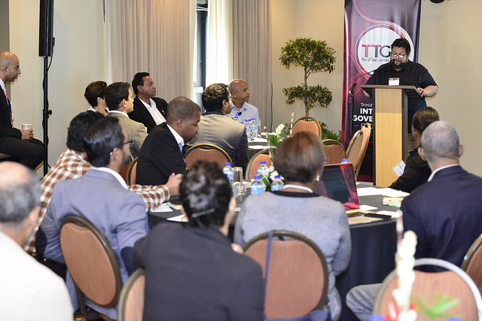
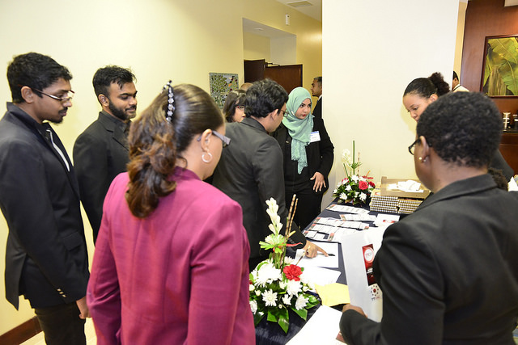
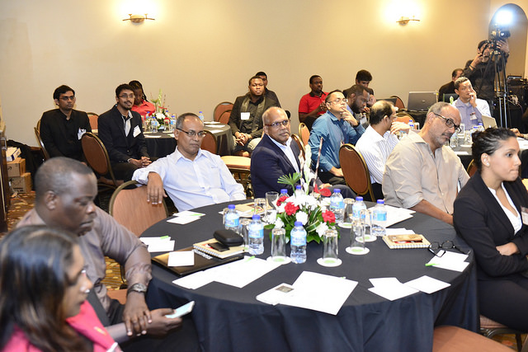
1st Trinidad and Tobago IGF
26 January, Port of Spain
Issues discussed: The Role of the Internet and the Digital Economy in the Sustainable Development of Trinidad and Tobago
Online participation available
IG Kids Academy

Slide 11
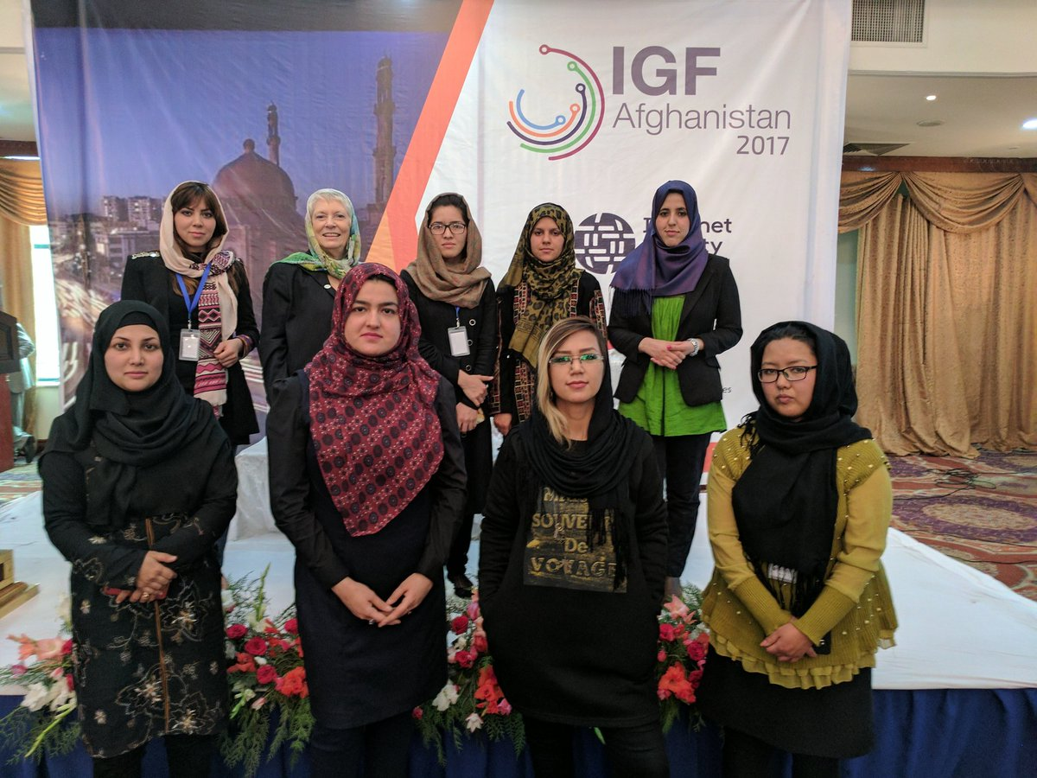
1st Afghanistan IGF
29 – 30 March, Kabul
200 participants
Issues discussed: Access & Diversity, Cyber Security, Youth and Gender, New emerging Issues
Simultaneous translation in Pashto, Dari, and English
Online participation available
Women in Tech
IG Kids Academy

Slide 12
3rd SEEDIG (IGF for South Eastern Europe)
24 - 25 May, Ohrid, FYR Macedonia
169 in situ participants from 24 different countries,
Issues discussed: Internet Governance, Broadband network challenges, Fake news and media literacy, IoT, Open Data, IDNs, Cybersecurity
SEEDIG Youth School
IG Kids Academy

Slide 13
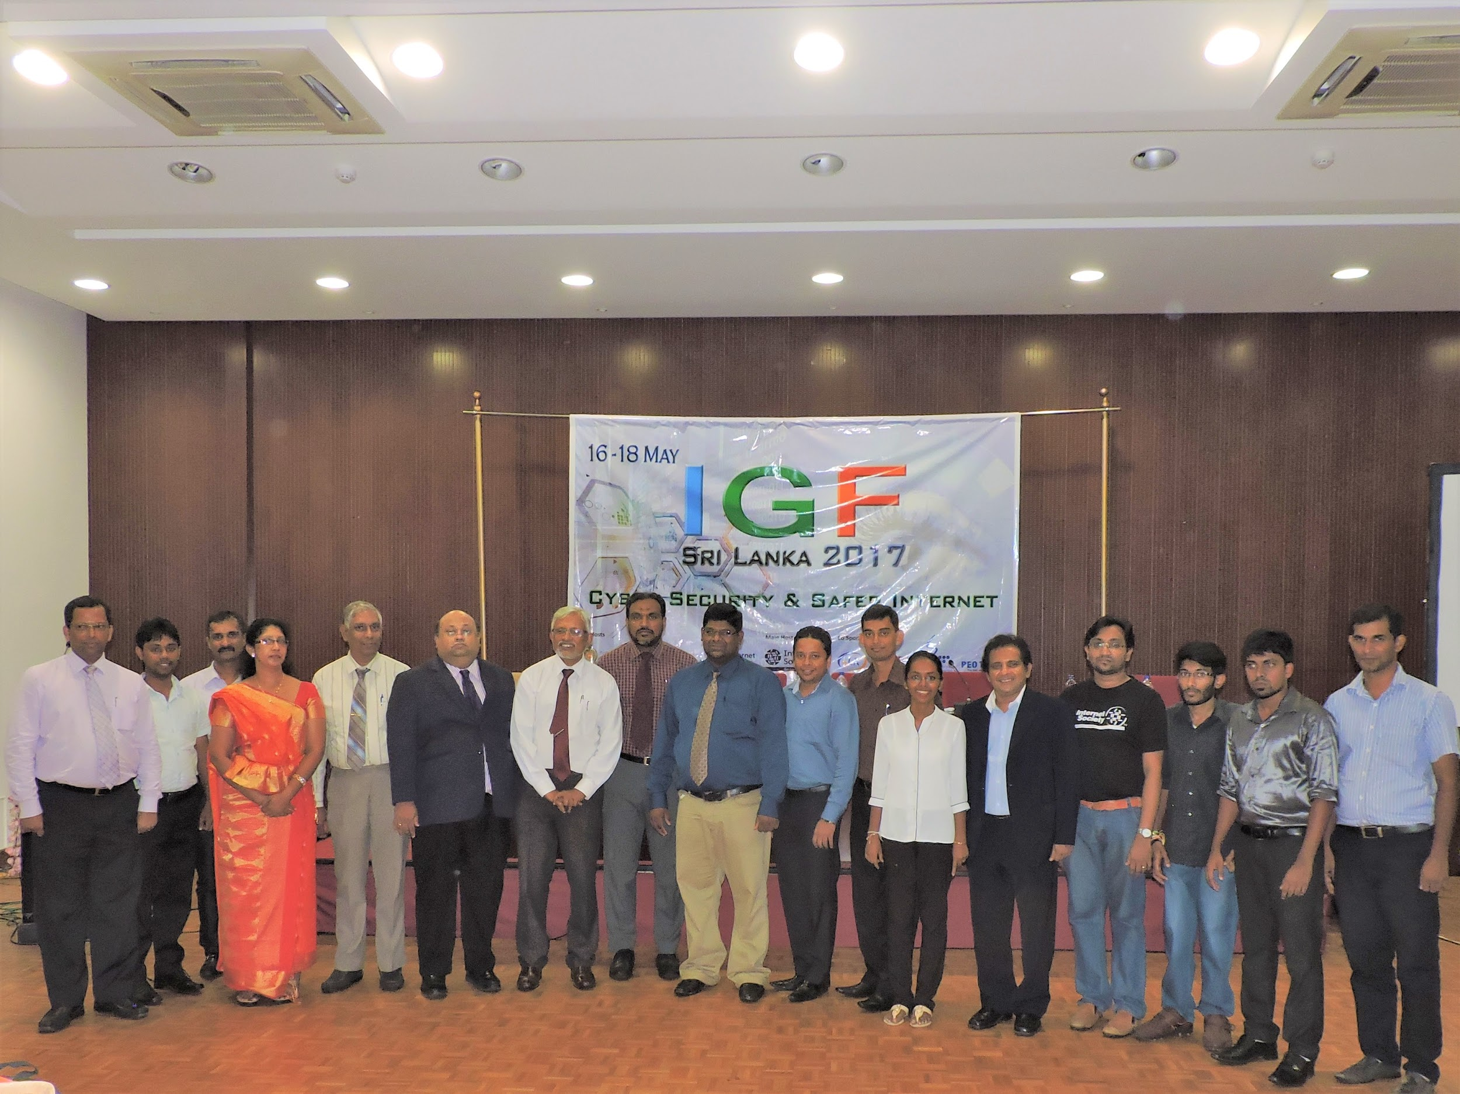
3rd Sri Lanka IGF
16 – 18 May, Colombo
100+ participants + online participants
Issues discussed: Internet Governance, Multistakeholder approach, SDGs and Internet, Cybersecurity and Safer Internet, Digital Rights
Youth IGF Initiative
Women of the IGF Sri Lanka
IGF Sri Lanka Village

Slide 14
How do the NRIs help the global IGF?
Submit concrete, written outcomes from their annual meetings and intersessional work, to the global IGF intersessional work (BPFs, CNEB);
Direct contributors to the IGF intersessional work by participating in the virtual and onsite meetings, and feeding into the discussion.

Slide 15
NRIs activities during the IGF 2016
NRIs Main Session on: access, secure Internet, funding sources, creating more awareness about IG and purpose of the stakeholder engagement;
NRIs Coordination Meeting between the global IGF, NRIs and the wider community
NRIs Booth at the IGF Village

Slide 16
IGF 2016: NRIs Toolkit to assist communities in establishing the IGF initiatives
As called for in the IGF2015 Substantive Session of the NRIs, the IGF Secretariat in collaboration with the NRIs Working Group and the NRIs developed a basic “Toolkit” publication to support new NRI Initiatives and strengthen the engagement of existing NRIs.
The Toolkit provides some broad background information and outlines the basic requirements for an IGF initiative to be listed on the IGF website.
It has been translated to five official UN languages (Arabic, Chinese, English, Russian and Spanish) by the volunteers among the NRIs network.

Slide 17
NRIs Plans for the IGF 2017
NRIs Main Session
Through a bottom up process, the NRIs have identified the main area of interest for this session to be: Rights in the digital/online world.
NRIs Collaborative Sessions
In order to bring specific, substantive inputs to the global IGF, the NRIs are willing to collaborate among themselves and organize sessions at the IGF 2017 meeting
Some of the specified areas of interest are:
Cybersecurity
Access
Data
Human Rights and Digital Rights
New emerging technologies
New emerging IG issues
Internet Governance
Internet and Sustainable Development
Continuing the Substantive, Coordination Session between the NRIs, the global IGF and the wider IGF community to review work that has been done so far and plan the new cycle
Development of improved approach to a shared booth and professional materials to support the booth
Continuation of the informal gatherings of the NRIs during any event that allows it

Slide 18
Contributing to the NRIs
Engaging with the NRIs is based on inclusion and engagement at the national, sub-regional and regional levels.
All NRIs are encouraged to maintain an open door to their outreach and engagement with their relevant stakeholders. All are required to maintain a point of contact and a working email to which local inquiries can be sent.
The annual required reports are also excellent resources to learn more about any particular NRIs activities.
In addition, the IGF Secretariat maintains a dedicated email list for those who want to support the work of the NRIs or attend their working calls. Meeting reports are provided for all of the working calls and available in the NRIs archive – thus open to the interested public.
For any NRIs related questions, contact the IGF Secretariat at: igf@unog.ch where a dedicated Focal Point to the NRIs will assist further.

