Slide 1
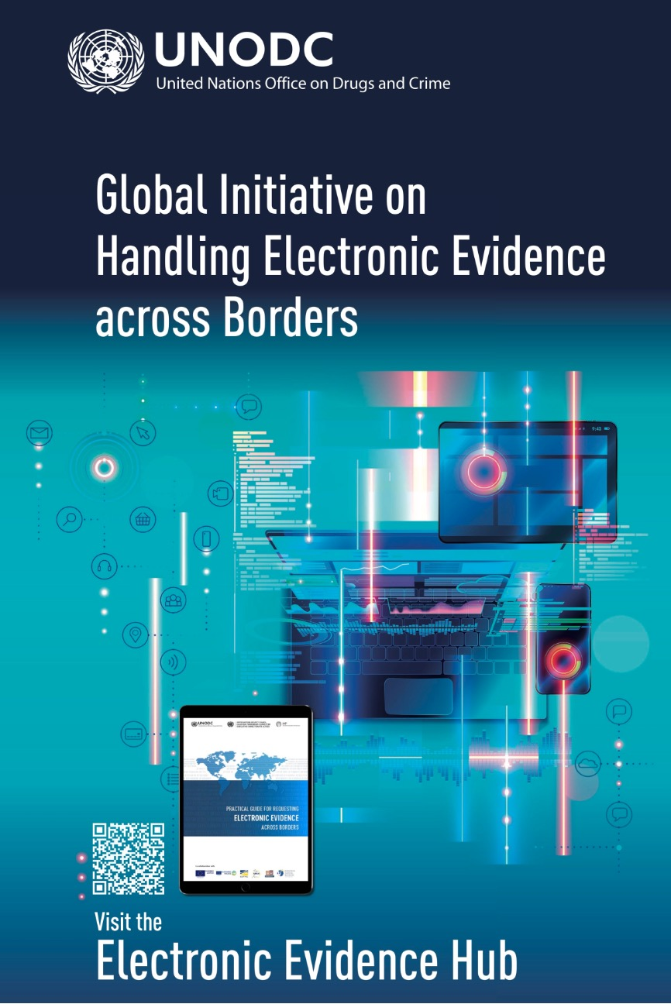
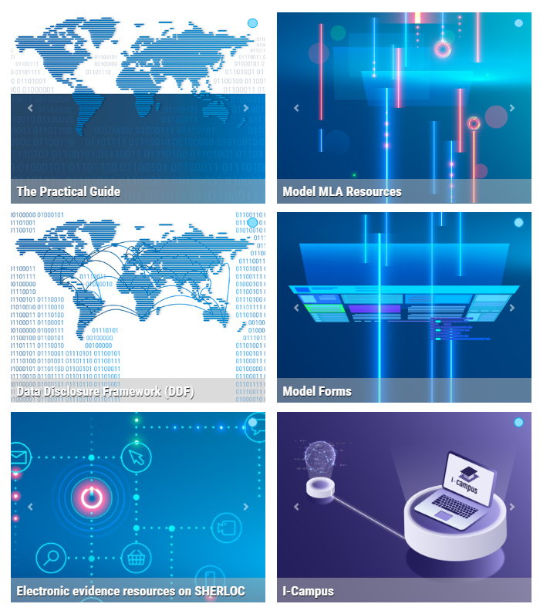
THE GLOBAL INITIATIVE
on Handling Electronic Evidence across
Borders
Building capacity of:
1) law enforcement authorities to identify, collect, acquire and preserve the electronic data needed to investigate terrorism offences;
2) prosecutorial and judicial authorities to use that data as evidence in court; and
3) central and competent authorities to handle and exchange that data across borders and jurisdictions, without jeopardizing/spoiling its admissibility and probative value at court.

Slide 2
