Slide 1


IGF Secretariat
2022 WORK PLAN
OVERVIEW

Slide 2

About us
The IGF Secretariat’s 2022 work plan is derived from its mandate, objectives set in its Project document, and contributions to Our Common Agenda and Global Digital Compact
IGF Mandate
Para 72 of the Tunis Agenda
Discuss public policy issues related to key elements of Internet governance in order to foster the sustainability, robustness, security, stability and development of the Internet
Facilitate discourse between bodies dealing with different cross-cutting international public policies regarding the Internet and discuss issues that do not fall within the scope of any existing body;
Interface with appropriate inter-governmental organizations and other institutions on matters under their purview;
Facilitate the exchange of information and best practices, and in this regard make full use of the expertise of the academic, scientific and technical communities;
Advise all stakeholders in proposing ways and means to accelerate the availability and affordability of the Internet in the developing world;
Notes:
https://www.itu.int/net/wsis/docs2/tunis/off/6rev1.html

Slide 3

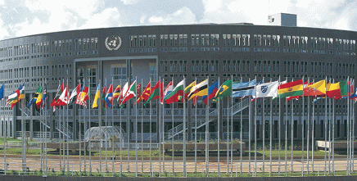
.
3 Open Consultations and Multistakeholder Advisory Group meetings
  Resilient Internet for a shared sustainable and common future”.
Call for Session Proposals
Design of Hybrid format
Remote Hubs
Host Country Collaboration
Host Country Agreement
Proposed dates 28 November – 2 December
Notes:
The MAG decided after listening to community input that the main over arching theme for this year be “A Resilient Internet for a shared sustainable and common future”. Which purposely includes words that resonate with our common agenda and the Sustainable development Goals.
The Forum’s main themes, on which thousands of stakeholders are expected to organize different sessions, will include themes aligned to the focus areas of the Global Digital Compact; In this way, IGF participants will have a concrete way to comprehensively - through multistakeholder lenses - express their views about the Compact.
Branding
connect all people to the Internet, including all schools;
avoid Internet fragmentation;
protect data;
apply human rights online;
introduce accountability criteria for discrimination and misleading content;
promote regulation of artificial intelligence; and
digital commons as a global public good.

Slide 4
Intersessional Work
Best Practice Forums on Gender and Digital Rights; and Cybersecurity
Policy Networks: on Environment, and Internet Fragmentations
Dynamic Coalitions
Parliamentary track
Capacity Development
Youth Development
Support for Schools for Internet Governance
Travel support of participants and experts
Notes:
Best Practice Forum on Gender
Best Practice Forum on Cybersecurity
Policy Network on Environment
Policy Netwok on Internet Fragmentation

Slide 5
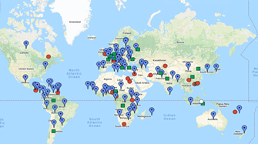
National & Regional IGF Initiatives (NRI’s)
Notes:
Good internet Governance begins at the local level
Help coordinate 150 NRI
Small grants 100K
Small Island States

Slide 6
Cooperation
Inter divisional cooperation within DESA
Other UN bodies : UNCTAD (CSTD); ITU (equals programme, WSIS); UN Women, Tech Envoys office, UNESCO WIPO, IPU etc.
European Commission (HLG) ; African Union, ICANN, ISOC, Tech companies and community at large.
Expert Group Meeting - 30 March – 1 April
Hosted by the Mission of Finland to the United Nations in New York

Slide 7
شكرا
谢谢
Thank You
Merci
Спасибо
Gracias

