Slide 1
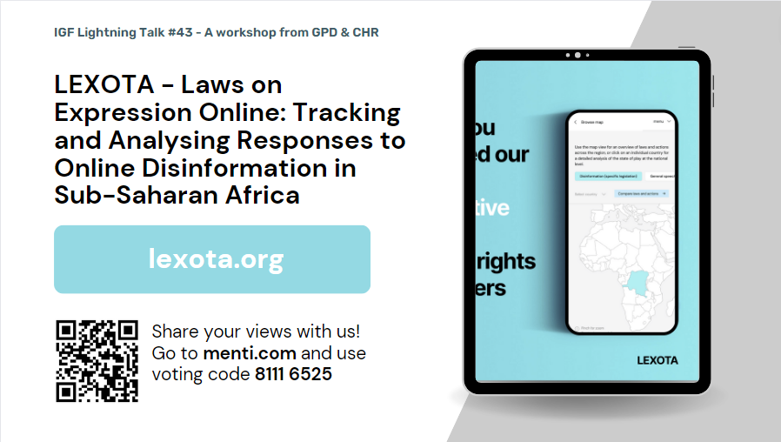
Notes:
Welcome everyone, pleased to be here today. This is our lightning talk called “LEXOTA - Laws on Expression Online: Tracking and Analysing Responses to Online Disinformation in Sub-Saharan Africa”.

Slide 2
Notes:
We only have 30 minutes for this lightning talk, so we’ll dive right in.
Focus of the presentation: LEXOTA tool. Check it out.
What we plan to run through. Please do fill in the poll questions at the mentimeter link
“Is imprisonment an appropriate punishment for spreading disinformation online?” [Yes/No/It Depends]
“What does a rights respecting response to disinformation look like?” [open ended]
To kick us off: We are part of a consortium of partners advocating for more rights-respecting responses to disinformation by governments in SSA. Other partners are CIPESA in Uganda, Article 19 West Africa in Senegal, and Protege QV in Cameroon.
As part of this work, we’ve developed a unique new tool for tracking and analysing disinformation laws across the region, called LEXOTA. This is the focus of this lightning talk today and we’re looking forward to sharing this with you.
Hand over to Marystella to tell us what LEXOTA is for - what is the problem that this tool aims to address?

Slide 3
Notes:
Q1: Is there clarity over the precise scope of the law? Individuals have to be able to know exactly what content is prohibited; prohibitions based on vague or ambiguous ideas such as “false news” or “non-objective information” would fail the test. Compare to civil defamation laws, which rely upon a well-defined definition and a demonstrable harm to reputation or professional earnings.
Q2: Is speech or content restricted online where it is in pursuance of a legitimate aim? Rule of thumb here is that the expression must cause a particular, qualifiable, harm to a particular individual/ group – for example, restrictions on expression that constitute incitement of physical harm, denial of genocide, could be permitted.
Q3: Do any restrictions in the law account for instances where the individual reasonably believed the information to be true? Civil law rules on liability for false and defamatory statements are legitimate only if defendants are given a full opportunity and fail to prove the truth of those statements and also benefit from other defences, such as fair comment.
Q4: Are determinations of whether speech or content is disinformation made by an independent and impartial judicial authority? Determinations on whether expression is in the scope of the law must not be made by the government or its officers
Q5: Are any responses or sanctions proportionate? In general, for an individual sharing false news online, even if deliberate, sanctions like heavy fines, imprisonment and website blocking are unlikely to be proportionate responses, particularly considering the actual harm caused. These criminal sanctions pose risks of serious interference with freedom of expression and are likely to be disproportionate in all but the most egregious cases. It’s also important to remember that criminal restrictions on disinformation may easily be misused to punish or deter political criticism.
Q6: Are intermediaries liable for third party content? This question is here because making internet intermediaries liable for “disinformation” massively incentivises them to remove first, ask questions later, and outsources the question of whether something constitutes disinformation or not under the law to a private company rather than an independent judicial body.

Slide 4
