Slide 1
WSIS Forum 2019 First Physical Meeting of the Open Consultation Process 12 November, 12:20 - 13:20 Room III, UNESCO Headquarters Presentation created by: Ms Gitanjali Sah and Mr Vladimir Stankovic, WSIS Secretariat, ITU

Slide 2
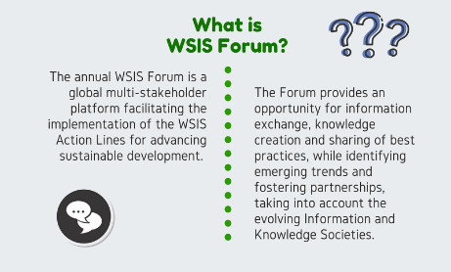
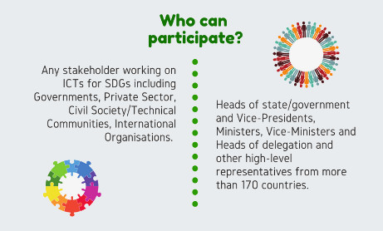
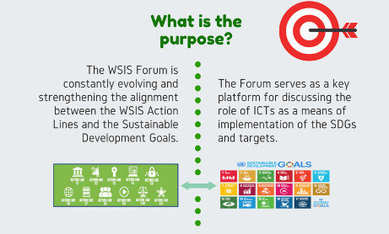
This year the WSIS Forum will showcase the advancements of frontier technologies for Social Development and Change. Technologies such as drones for social good, the human face of AI, the world of the rapidly-growing cryptocurrencies, digital platforms for socio-political change , 3D design, Design Thinking, 3D Printing, Mechanical Engineering, and Sustainable Process Design, use of emerging technologies in Sports including Video Assistant Referee (VAR), Electronic Performance and Tracking Systems (EPTS), Ultra High Definition video (UHD) and virtual reality (VR), and 5G in sports. Most importantly, hands-on experiences with Virtual Reality, Robot!, building, coding, physically designing and customizing a robot…

Slide 3
Reminder of Open Calls
WSIS Forum 2019:
8-12 April 2019 : Registration will be open 1 month in advance
High level Track on 9-10 April: Speaker requests for Ministers, CEOs and Head of Organizations will be available soon
Open Consultation Process Formal Submission: Deadline 10 February 2019
Call for High level Track Facilitators: Deadline 10 February 2019
Photo Contest : 10 February 2019
WSIS Prizes 2018: Deadline for Nomination: 30 November 2018!
WSIS Stocktaking 2019: 30 November 2018!
Notes:
I would now like to draw your attention to remind you of all the Open Calls towards the WSIS Forum 2019
WSIS Forum 2019:
8-12 April 2019 : Registration will be open 1 month in advance
High level Track on 9-10 April: Speaker requests for Ministers, CEOs and Head of Organizations will be available soon
Open Consultation Process Formal Submission: Deadline 10 February 2019
Call for High level Track Facilitators: Deadline 10 February 2019
Photo Contest : 10 February 2019
WSIS Prizes 2018: Deadline for Nomination: 30 November 2018!
WSIS Stocktaking 2019: 30 November 2018!

Slide 4
WSIS Forum Building Blocks

Slide 5
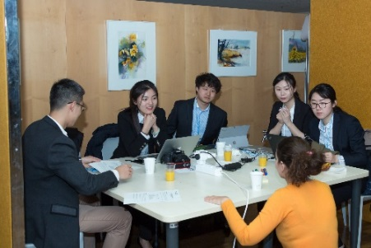
Open Consultation Process
Best Practices
WSIS Prizes
Special Tracks
Partner With Us
Virtual Reality for SDGs Pursuing a first partnership in 2016, WSIS and World VR Forum join forces to be at the forefront of Virtual Reality for advancing development. A shiny new Virtual Reality Track will be held at the WSIS Forum 2019 bringing together high-level personalities, world class VR experience and a very special focus on education. | TEDxGeneva After a successful edition last year, TEDxGeneva and the WSIS Forum are back to bring you to the crossroads of our fast-changing society--the crossroads of technology acceleration, human tradition, artificial intelligence, and an interconnected world. | Hackathon As a continuation of the discussions initiated at the 2016 WSIS Forum, first ever Hackathon was held successfully in 2017 on e-Health, and in 2018 the main topic was e-Agriculture. Next year a Hackathon on Hacking Solutions for Lifelong Learning and Livelihoods will be held at the WSIS Forum 2019. We invite all interested coders to participate in the WSIS Hackathon.
Other tracks : ICT Solutions for SDGs, Innovation Track, Youth Track, Accessibility Track
Notes:
Special Tracks at the WSIS Forum 2018:
Social Entrepreneurship Track:
Building on the requests received during the open consultation process, a new segment for the first time will be focused on start ups and other entrepreneurs to develop, fund and implement apps to contribute to the achievement of the SDGs.
Virtual Reality for Development
Pursuing a first partnership in 2016 and a successful track in 2017, WSIS and World VR Forum join forces to be at the forefront of Virtual Reality for advancing development. A shiny new Virtual Reality Track will be held at the WSIS Forum 2018 bringing together high-level personalities, world class VR experience and a very special focus on education.
TEDx Geneva
After a successful debut at WSIS Forum 2016 AND 2017- TEDxGeneva and the WSIS Forum bring you to the crossroads of our fast-changing society--the crossroads of technology acceleration, human tradition, artificial intelligence, and an interconnected world at the TEDx Geneva event during the WSIS Forum 2018
Hackathon:
a Hackathon on ICTs for SDGs focusing on Ending Hunger will be held at the WSIS Forum 2018. Iinvite all interested coders to participate in the WSIS Forum 2018 Hack Against End Hunger, Organized by ITU and FAO.

Slide 6
Open Consultation Process
Best Practices
WSIS Prizes
Special Tracks
Partner With Us
“The annual WSIS Forum has become a global multistakeholder platform for coordination of the implementation of the WSIS Outcomes, information exchange amongst the different WSIS Stakeholders, knowledge creation and the sharing of best practices. With the goal to evolve and adapt to the future needs of the Information and Knowledge Societies and WSIS process beyond 2015, I invite all Stakeholders to Partner with the WSIS Forum 2019 and look forward to working together towards an impactful Forum.”
Mr Houlin Zhao, Secretary-General, ITU
Notes:
Dear Ladies and Gentleman, the WSIS Forum is an extra - budgetary activity and every year we raise funds though Partnership and visibility packages. We invite you to partner with us for this important event that provides a multistakeholder platform for coordination of the implementation of the WSIS Outcomes.

Slide 7
Thank You
www.wsis.org
www.wsis.org/sdg
www.wsis.org/forum
www.wsis.org/prizes
www.wsis.org/stocktaking
www.wsis.org/review
wsis-info@itu.int
Open Consultation Process
Best Practices
WSIS Prizes
Special Tracks
Partner With Us

